Slide 1

Exploiting a Double Race Condition to RCE in Concrete CMS

Slide 2

whoami
Adrian Tiron
Founder & Principal Pentester @FORTBRIDGE
Certifications:
OSCP/CRTO/CRTL/AWS/Azure/CDP/OSEP
Conference Speaker
BSides Dresden, BSides Kent, BlueHatIL , Bsides Budapest
Fixing Security pain points
2

Slide 3


WHATIS THIS TALK ABOUT? (APPSEC)
3

Slide 4

Race condition everywhere! Double Race condition?
4

Slide 5
About Concrete CMS
•
Easy to use CMS
•
Written in PHP (<3)
•
More than 62K live websites
•
Used by the US DoD and US army
•
HackerOne bug Bounty (no $, just fame)
•
This was initially a project sponsored by one of our biggest London clients
•
After thisre search PortlandLabs became our client
Fixing Security pain points
5

Slide 6
Concrete CMS –White Box Pentest
•
Source code is available, let’s do white box
•
Code is PHP, easy to read and audit
•
Some issues reported previously reported on hackerone
•
Many issues reported by FORTBRIDGE with plenty of CVEs assigned
Fixing Security pain points
6

Slide 7
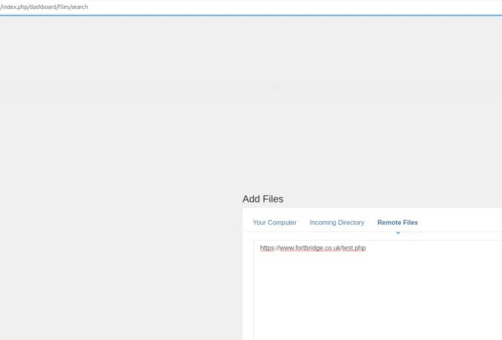
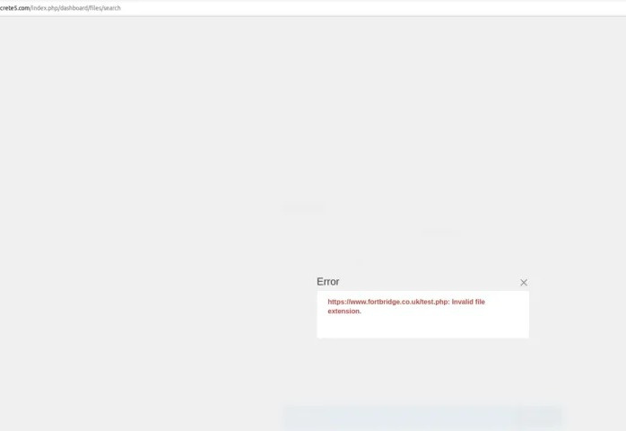
Concrete CMS –File Uploads are fun
Fixing Security pain points
7

Slide 8
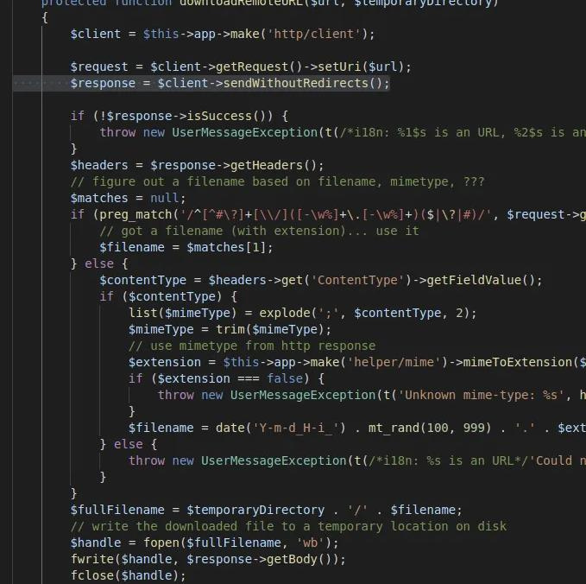
Concrete CMS first race condition
•
File is downloaded from remote server (auth SSRF by design)
Low Privileged user is needed
First the file is written on the system, then validation is done
If it fails validation, then it’s
deleted (?!?!?)
•
•
•
8

Slide 9
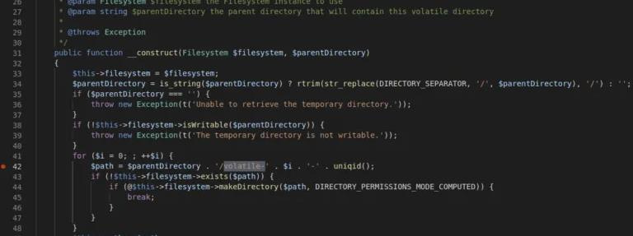
Concrete CMS –
pseudo random dir name
•
uniqid() is used to create a temp dir
•
uniqid() is not a crypto secure function
Fixing Security pain points
9

Slide 10
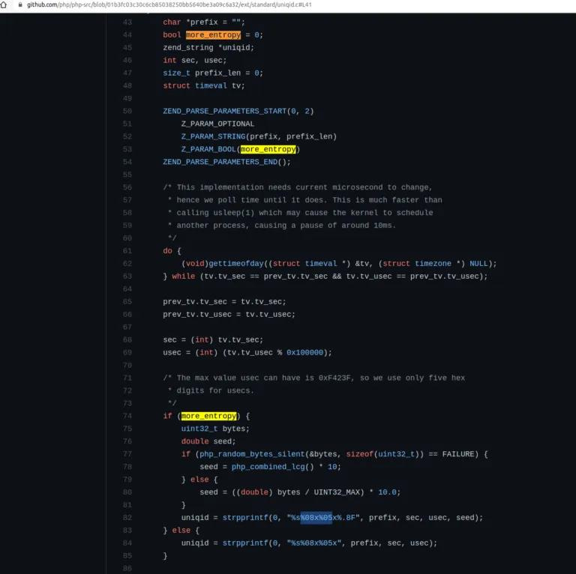
PHP uniqid() implementation
Uniqid() relies on seconds and microseconds
Both are deterministic and bruteforce-able
Let's read some PHP internals code for fun & profit
10

Slide 11
We need to find the name of the temp dir where our file is written(1st step)
Concrete CMS - Exploitation plan
For this we need to make sure the file we download will execute/sleep for a long period of time so we can guess the dir name
We’ll use Turbo Intruder to bruteforce and guess the temp dir name
Our download file + temp dir will get deleted eventually so it will need to write a permanent shell for persistence and RCE
How do we trigger our download file before it gets deleted? (2nd race condition)
Fixing Security pain points
11

Slide 12
Concrete CMS –temporary shell
Temp shell written first which will write a perm shell in the parent dir
<?php set_time_limit(0); sleep(35); echo '<?php file_put_contents("../shell.php","<?phpsystem(\$_GET[c]) ;");'; echo '?>' . str_repeat("A",50000000); flush(); ob_flush(); ?>
Fixing Security pain points
12

Slide 13
Concrete CMS
Timeline of race conditions
TO = start search
for volatile dir
T1-found dir,
start search for
test.php
T3=test.php is
found & exec-
ed, perm shell is
written
T4=test.php &
volatile dir are
deleted
T2=test.php is
written locally
Fixing Security pain points
13

Slide 14
Concrete CMS –Timeline of 2 races Explained
T0 you start the upload request AND you also start searching for the the volatile dir name. You have 1M possibilities, we managed to send 16-17K RPS, so you can easily brute-force 500-700K in ~30 seconds, that’s a 50% chance, works great. We didn’t queue 1M requests, due to some issues with Turbo Intruder.
T1 you discover the volatile dir name (win first race), but test.php is not there yet. Thus you have to start searching for test.php (2nd race condition in the file upload) which will ALWAYS be written after ~30 seconds (after T0). We’ll queue another 500K requests in Turbo Intruder for this.
T2 (~ 30th second) test.php is written locally, inside the volatile dir
T3 one of the queued requests from T1 executes test.php and writes a permanent shell in the parent directory (“/application/files/tmp”)
T4 both volatile dir and test.php inside are deleted, but we already have a shell 🙂
Fixing Security pain points
14

Slide 15
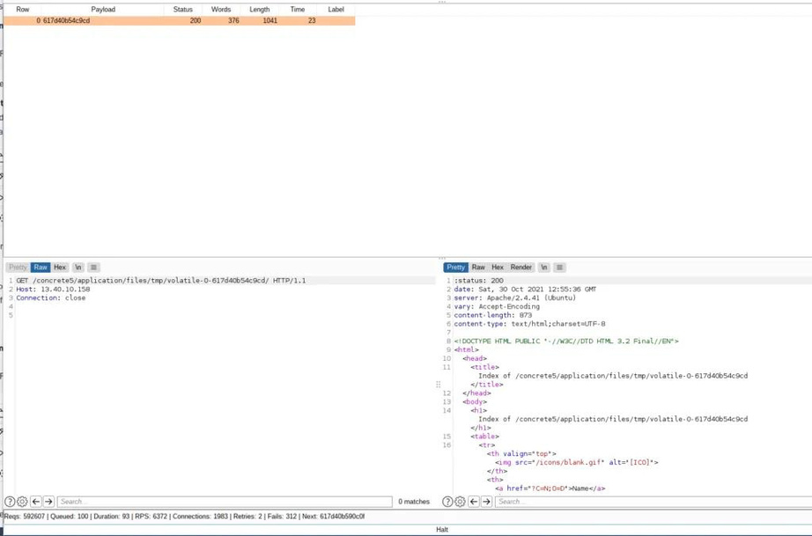
Concrete CMS –1st race - guess the Temp Dir
Fixing Security pain points
15

Slide 16

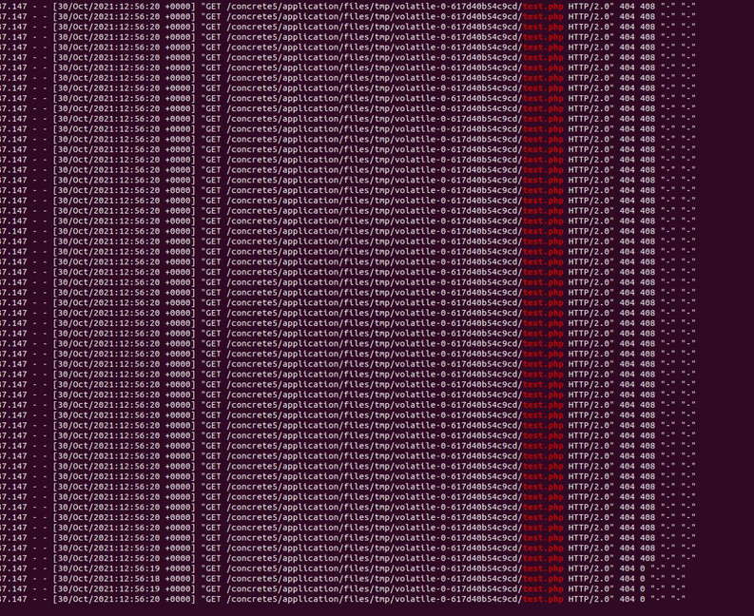
Concrete CMS -
2nd race trigger the uploaded file before deletion
Fixing Security pain points
16

Slide 17
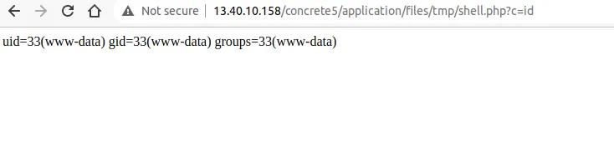
Concrete CMS –The Glorious Win
Remote exploit with Turbo Intruder
Fixing Security pain points
17

Slide 18
Concrete CMS – Debugging Tips
the timeout for curl is 60s, dont sleep() more than 60s in test.php
use http2 if possible (for speed, it’s easier to win the race conditions)
use tail -f access_log and tail -f error_log to monitor your requests and any errors
check that your upload request from request.txt is still a valid session
the upload request must come from a single ip by default
Fixing Security pain points
14

Slide 19
Concrete CMS –Solution?
Upgrade to latest version
Our Team has reported many issues (lots of CVEs received)
Concrete CMS team has been great to work with over the past few years, kudos to them! !!
Fixing Security pain points
18

Slide 20


Q
A
&
19

Slide 21

Let's connect
Fixing Security pain points
20

Slide 22


